Slide 1
Quantum Physics
VIT University, Bhopal
Course Name: PH
Notes:
http://www.askamathematician.com/2013/04/q-why-is-schrodingers-cat-both-dead-and-alive-is-this-not-a-paradox/

Slide 2
Lecture 1

Slide 3
Evolution of Quantum mechanics
1922:
Neils Bohr won Nobel Prize in physics
Stern-Gerlach space quantization
1925:
Heisenberg Uncertainty principle
Wolfgang Pauli spin number
1940: Pauli proves Spin-Statistic Theorem
1932:
Werner Heisenberg won Nobel Prize in physics
1918:
Max Planck won Nobel prize in physics
1944:
Pauli won Nobel Prize in physics
1905:
Albert proposed the idea photoelectric effect.
1936: Schrödinger's Equation
1924:
Louis De Broglie electron waves.
1921:
Won the Nobel Prize in Physics photoelectric effect.
1929: Louis De Broglie won the Nobel Prize.
1933:
Otto Stern measures the magnetic moment of the proton
Schrodinger Schrodinger Equation
1943:
Otto Stern Nobel prize in Physics
1900:
Max Planck black-body radiation
1913:
Neils Bohr atomic structure

Slide 4
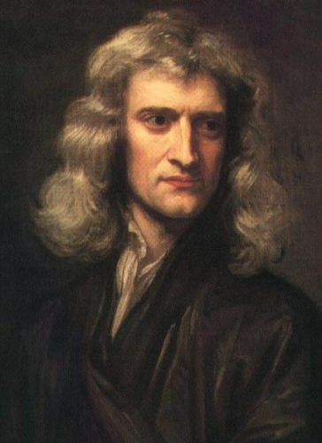

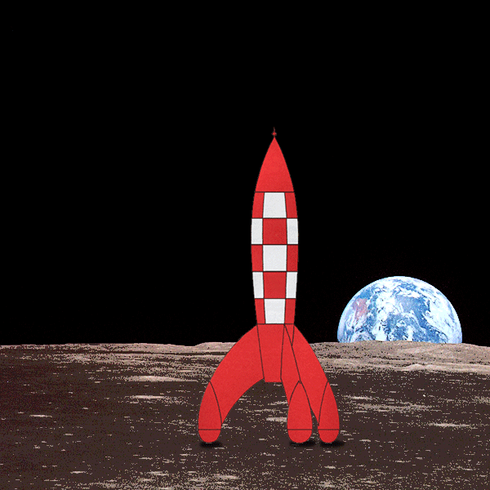
Limitations of Classical theory, Basic idea of quantization
Newton's classical theory
Maxwell’s Electromagnetism theory
Mainly deal with macroscopic phenomenon

Slide 5
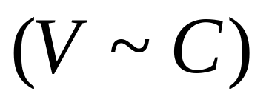
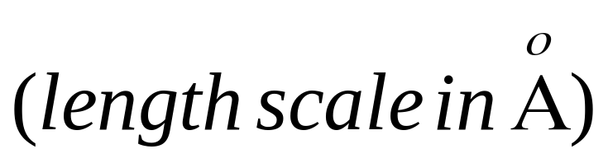
Failure of Classical physics
Relativistic domain
Microscopic domain
Classical physics fail to explain
  Black body radiation
  Photo electric effect
  Atomic stability
  Atomic spectra
  The stability of atoms , spectral distribution of black body radiation

Slide 6
Development of Quantum Mechanics
Max Planck's Hypothesis
Heisenberg’s Uncertainty principle
Schrodinger equation

Slide 7
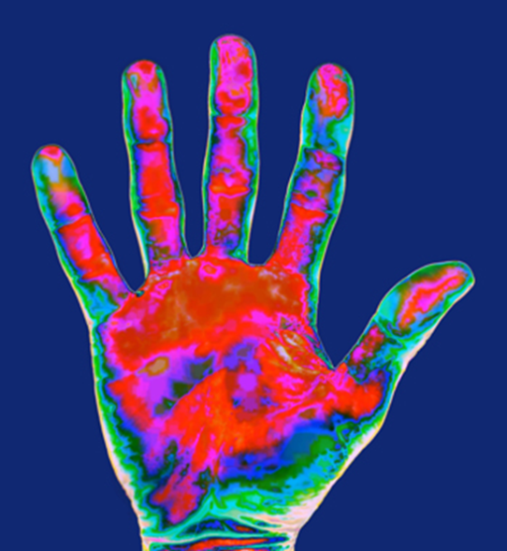
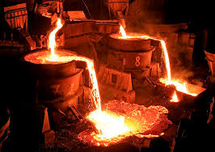
All objects with a temperature above absolute zero emit thermal radiation.
Notes:
© Shutterstock 2009, James Doss

Slide 8
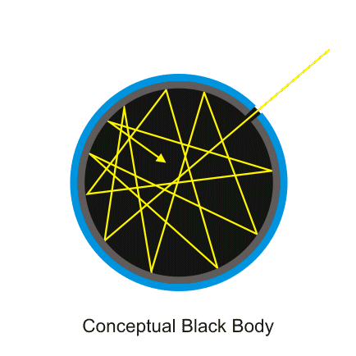
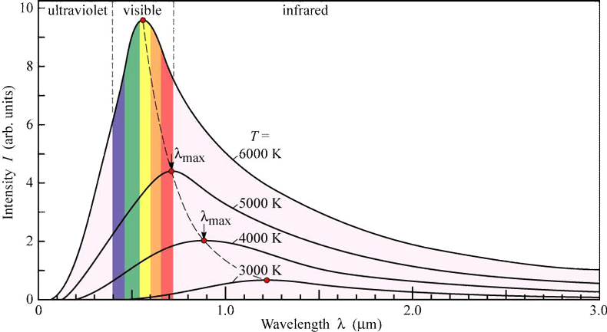
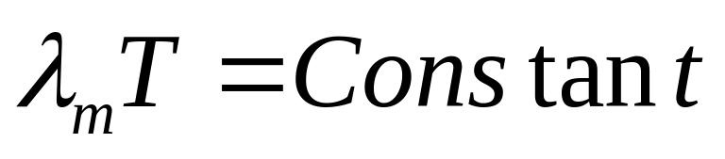
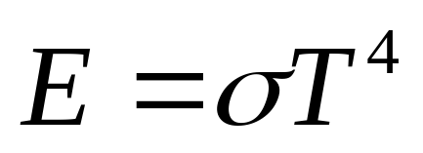
Black Body
https://phet.colorado.edu/sims/blackbody-spectrum/blackbody-spectrum_en.html
Issue is how radiation interacts with matter
Black body is a material which absorbs all energy falls upon it,
and hence appears black with respect to reflection.
Wien’s displacement law
Stefan’s law
Notes:
Image courtsey: https://physics.stackexchange.com/questions/173409/relationship-between-temperature-and-wavelength

Slide 9
What classical physics predicted
Using classical ideas (equipartition theorem + wave theory), physicists derived the Rayleigh–Jeans law, which said:
Energy emitted should increase indefinitely at short wavelengths (high frequency).
This implied an infinite energy output — called the ultraviolet catastrophe.
👉 Experimentally, however:
Intensity rises, reaches a peak, then falls at high frequencies.

Slide 10
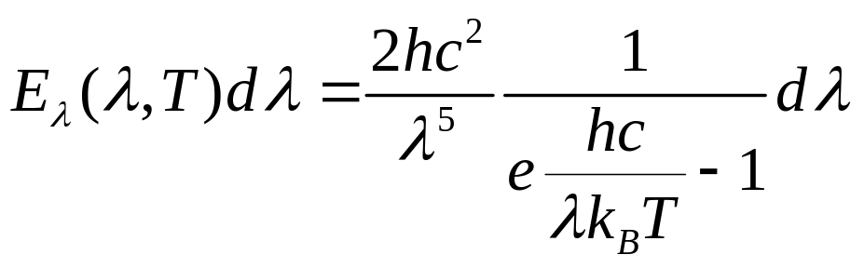
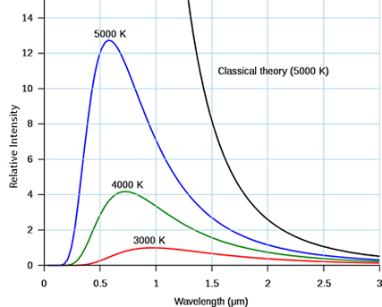
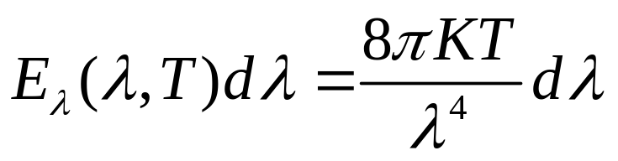
Activity:
1. Convert lambda to frequency
2. Plot it
Wien’s law
UV catastrophe
Rayleigh Jeans Law
Notes:
Image courtsey https://sites.google.com/a/whbschools.org/grodski-ap-chemistry/archives/2012-2013/2---quarter/week-4

Slide 11
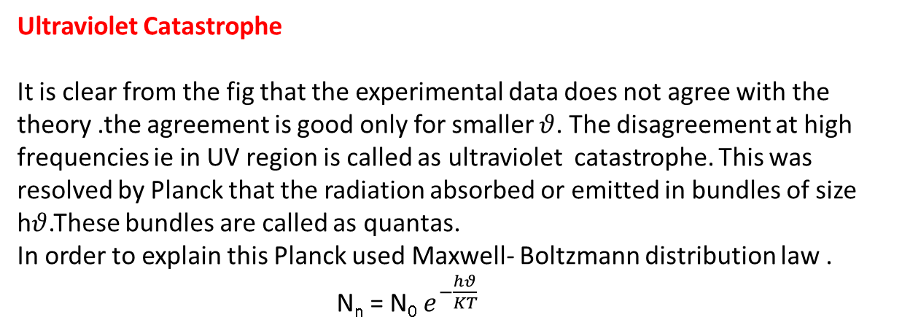
Ultraviolet Catastrophe
It is clear from the fig that the experimental data does not agree with the theory .the agreement is good only for smaller $θ$. The disagreement at high frequencies ie in UV region is called as ultraviolet catastrophe. This was resolved by Planck that the radiation absorbed or emitted in bundles of size h$θ$.These bundles are called as quantas.
In order to explain this Planck used Maxwell- Boltzmann distribution law .
N_{n} = N₀ $e^{−\frac{hθ}{KT}}$

Slide 12

Light bulb experiment to explain black body spectra
ACTIVITY
A current flows through the filament.
The filament heats up.
The thermal emission of the filament moves into the visible spectrum.
Notes:
Photo credit: © Shutterstock 2009, ER_09

Slide 13
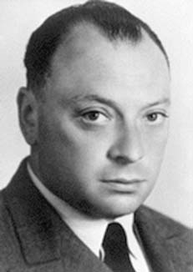
Wolfgang Pauli
(1900-1958)
Austrian born - Swiss
"At the moment physics
is again terribly confused.
...I wish I had been a movie
comedian or something
of the sort and had never
heard of physics."

Slide 14
Lecture 2

Slide 15
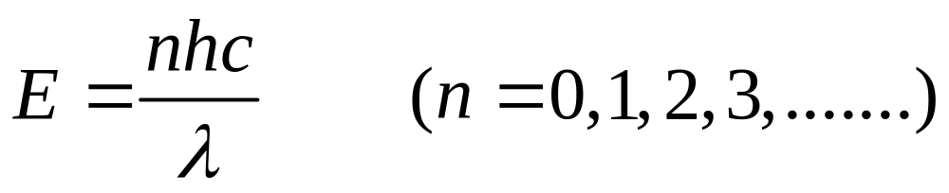
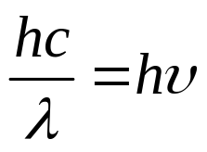




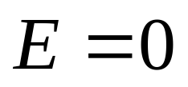
Planck’s law
Radiated energy interacts with the cavity walls in a quantized manner
One quanta of energy

Slide 16
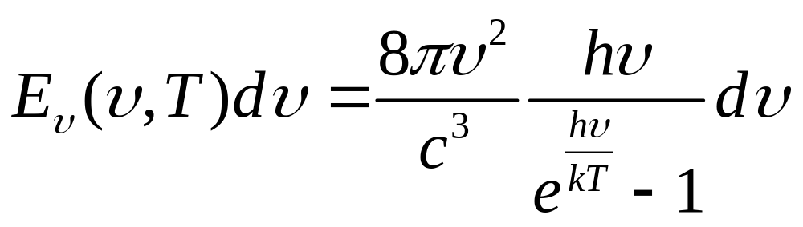
Planks law of radiation
Activity:
Convert frequency to lambda
Prove Wien’s law and RJ law as a
limiting case of Planks Law

Slide 17
Expt. To determine Planck's const

Slide 18
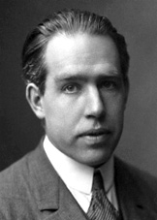
Niels Bohr(1885-1962)
Danish
"Those who are not
shocked when they
first come across
quantum theory cannot
possibly have
understood it."

Slide 19
Lecture 3

Slide 20
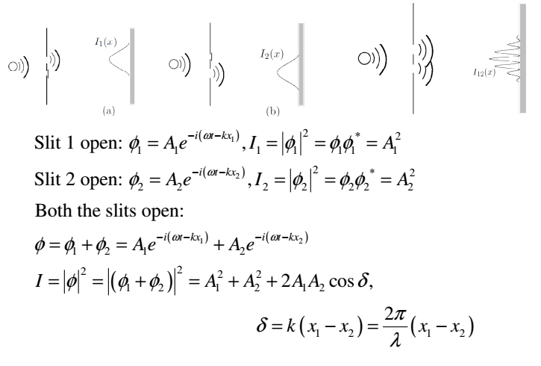
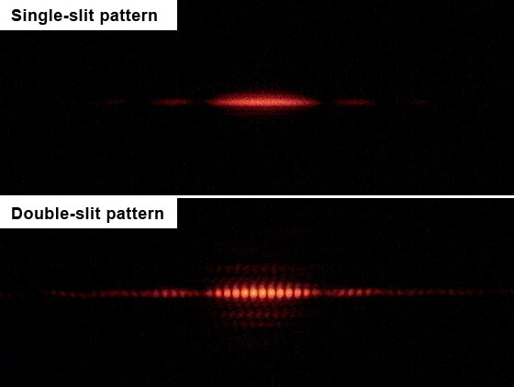
Dual nature of electromagnetic radiation- de Broglie waves ,
Notes:
Image courtsey: https://physics.stackexchange.com/questions/15854/why-does-davisson-germer-experiment-confirm-electrons-wave-particle-duality
https://en.wikipedia.org/wiki/Double-slit_experiment#/media/File:Single_slit_and_double_slit2.jpg

Slide 21
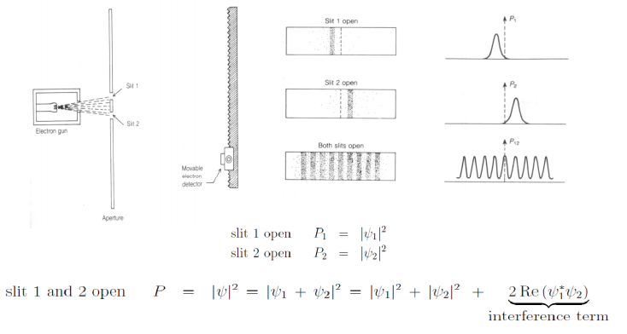
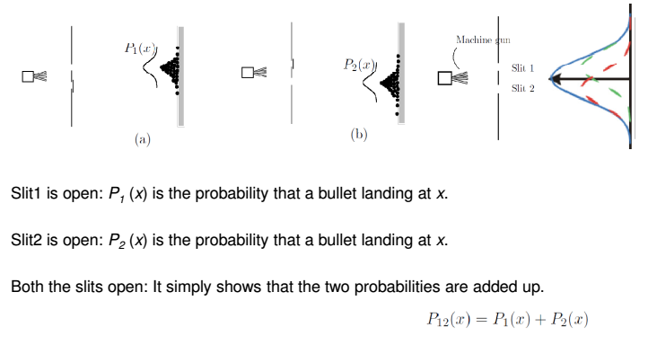
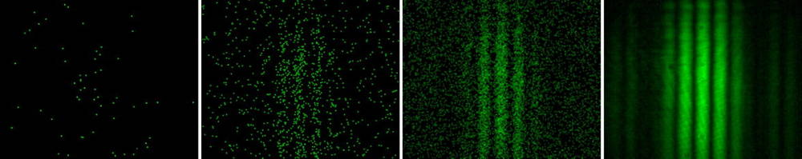

Slide 22
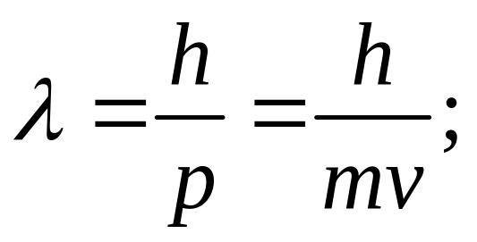
Matter Wave
Wave Particle Duality:
  matter can behave both like particles as well as waves.
  Louis de Broglie
  If a particle of mass m moves with a velocity v
  then it behaves like a matter wave having a
  wavelength λ given by

Slide 23
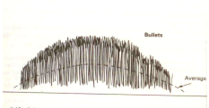
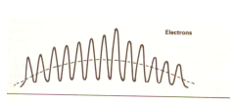
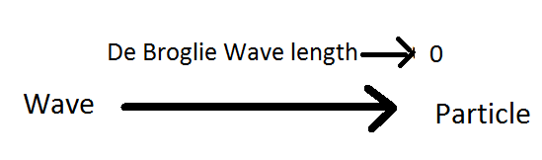
Why bullets different from electron
Bullets are far more massive than the electrons. One can observe them as long as one likes but it would not make any difference to them.
There are interference wiggles in the case of bullets also. The are so crowded that it is physically impossible to resolve them, one sees an average behaviour

Slide 24
Expt. on de-broglie

Slide 25
1.A fast moving neutron is found to have an associated de-Broglie wavelength of 2x10⁻¹² m. Find the Kinetic energy, phase velocity and group velocityo f de-Broglie waves ignoring the relativistic change in mass.( 3.2x10⁻¹⁷ J,1.98X10⁵ m/s, 4.55x1011m/s)
2. Calculate the de- Broglie wavelength associated with a proton moving with a velocity equal to 1/20 th of the velocity of light .
3. Show that the de- Broglie wavelength for a material particle of rest mass m₀ and charge q, accelerated from rest through a potential difference of V volts relativistic ally is given by ?
4. Calculate de-Broglei wavelength associated with nitrogen at 3.0 atmospheric pressureand 27⁰ c.

Slide 26
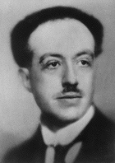
de Broglie(1892-1987)
French
``Two seemingly incompatible conceptions
can each represent an aspect of the truth … They may serve in turn to represent the facts without ever entering into direct conflict’’.

Slide 27
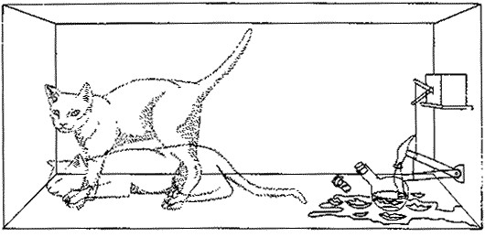
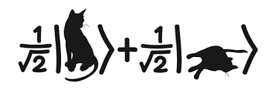
Lecture 4

Slide 28


Heisenberg uncertainty principle
Sets limit on what we can observe.
Asking about position and momentum, one can not
get a definite answer; only a probabilistic answer is possible.

Slide 29
Determine the uncertainty in the motion of a man (50Kg) moving with velocity 2 m/sec, and an electron.

Slide 30
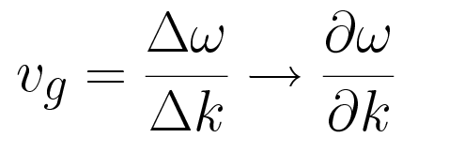
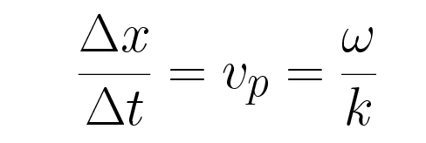

Wave packet, group and phase velocity
Wave packet is consist of a group of waves, having slightly different
wavelength, with phase and amplitude so chosen that they
constructively interfere at a small region of space and destructively
elsewhere
Group velocity= velocity of the group of waves.
Phase velocity =The speed with which the
constant phase moves

Slide 31
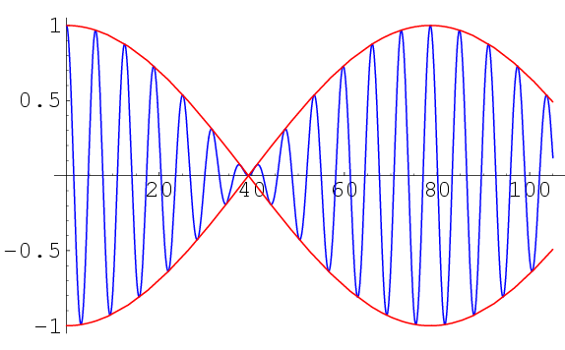
Group Velocity
Phase velocity

Slide 32
1.The uncertainty in the location of a particle is equal to its de-Broglei wavelength. Calculate the uncertainty in its velocity
2.The position and momentum of a 1.0Kev electrons are simultaneously measured. If the position is located within 1A⁰ .What is the percentage of uncertainity in momentum?
3.A hydrogen atom is 0.53A⁰in radius. Use uncertainty principle to estimate the minimum energy an electron can have in this atom
4A proton and a deuteron have the same kinetic energy. Which has a longer wavelength?

Slide 33
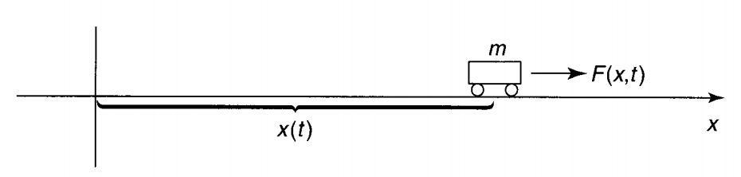
Wave function and its properties
Classically we can measure the actual position {x(t)} of the car by applying Newton’s law
But in Quantum mechanics we look for the wave function (known as “state function”)
The wave function associated with the particle can represent its state and the
dynamics would be given by Schrodinger equation
But what exactly is this "wave function", and what does it mean? After all, a particle,
by its nature, is localized at a point, whereas the wave function is spread out in space
(it's a function of x, for any given time t). How can such an object be said to describe
the state of a particle?

Slide 34
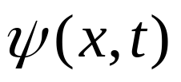
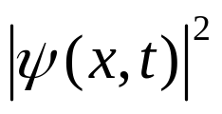
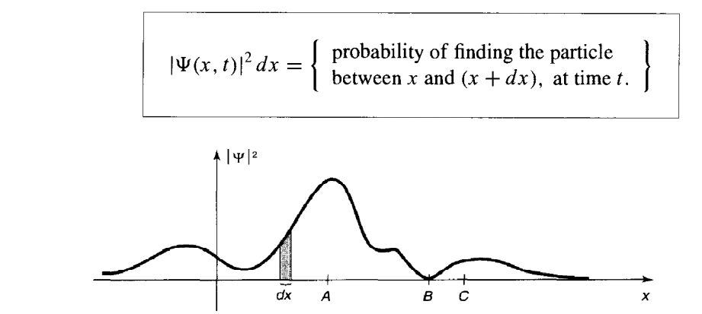
Born's statistical interpretation of :
gives the probability of finding the particle between x and +dx, at time t or,
more precisely

Slide 35
Classical physics is deterministic
Quantum physics is probabilistic
``God does not play dice”
A. Einstein

Slide 36
property
Wave function contain the information of all the measurable quantity
Wave function is normalised
It is continuous
We can calculate energy by using this function
Expectation value can be calculated

Slide 37
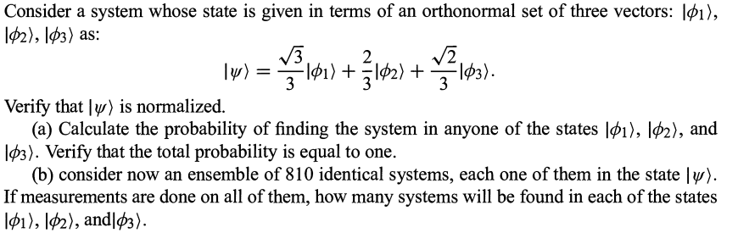
Tricky Problem

Slide 38
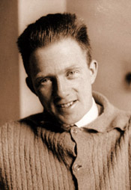
Werner Heisenberg
(1901-1976),German
‘‘The atom of modern
physics can be symbolised
only through a partial
differential equation in
an abstract space of many
dimensions. All its qualities
are inferential; no material
properties can be directly
attributed to it.”

Slide 39
Lecture 5
Schrodinger’s Time dependent and Time Independent Equation

Slide 40
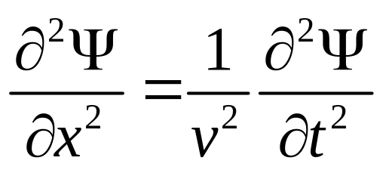
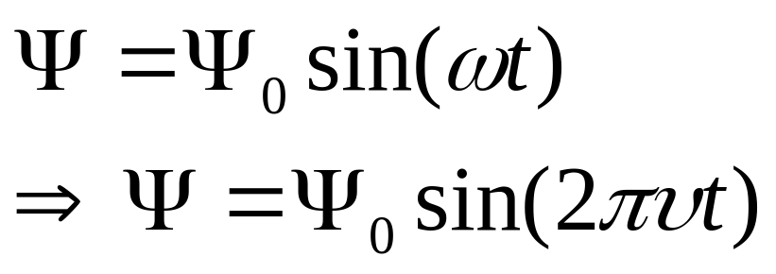
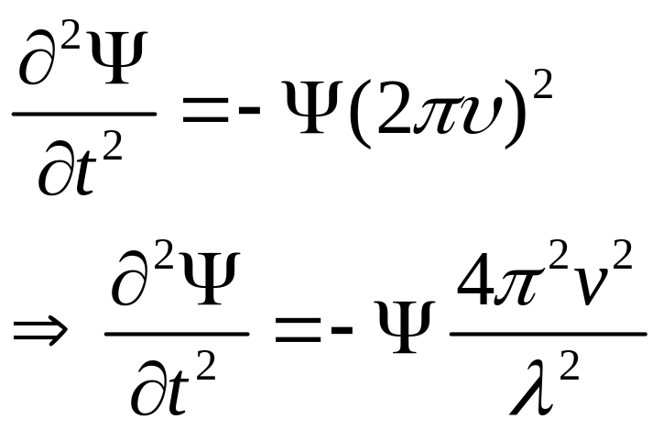

Slide 41
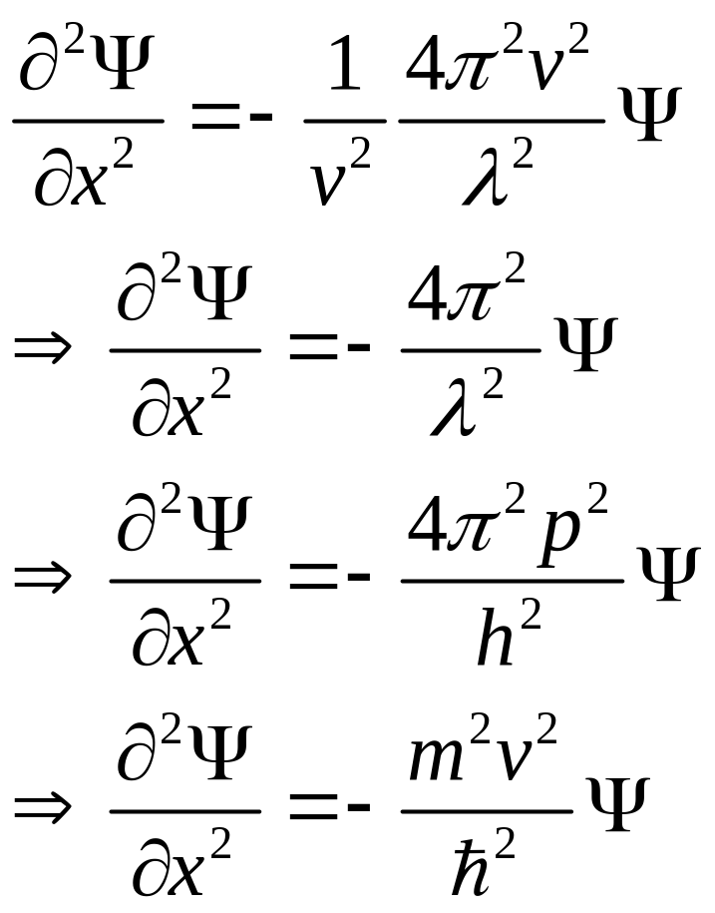

Slide 42
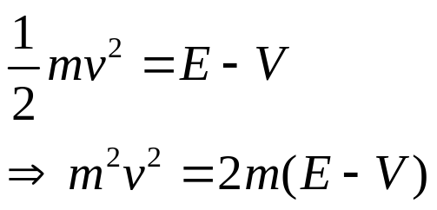
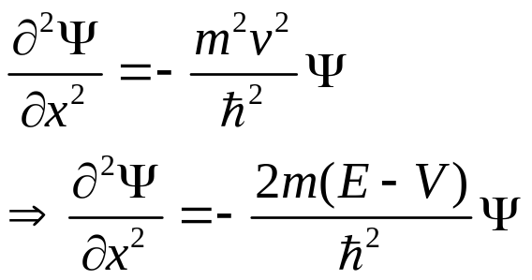

Slide 43
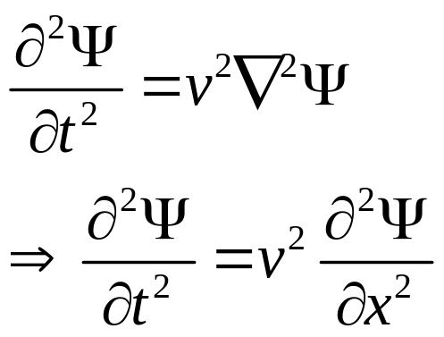
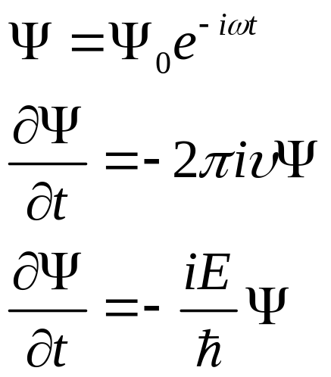

Slide 44
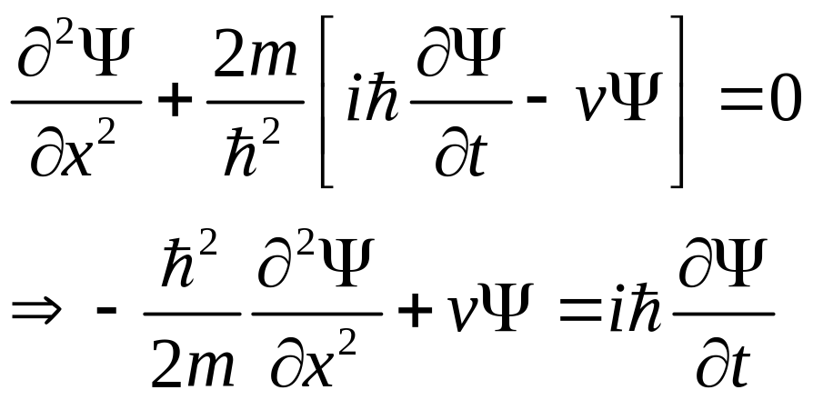
Schrodinger’s Time dependent Eq.

Slide 45

Erwin Schroedinger
(1887-1961) Austrian
‘‘..the task is, not so
much to see what no
one has yet seen; but
to think what nobody
has yet thought, about
that which everybody
sees. ’’

Slide 46
Lecture 6

Slide 47



Eigen value
Operator
Eigen function
When Schrodinger equation is solved for different values of energy it is called as eigen values and the corresponding function is called as eigen functions.

Slide 48


Slide 49


Slide 50


